Slide 1


Tekton, une nouvelle approche des pipelines Philippe THOMAS IBM Client Engineering ph_thomas@fr.ibm.com www.linkedin.com/in/phthom https://github.com/phthom

Slide 2
Tekton, une nouvelle approche des pipelines
Agenda
1- Cloud Native Pipelines
2- Tekton Concepts
3- Example
Notes:
Voici un sommaire du sujet en 3 parties : une intro assez rapide, le concept des pipelines sur Tekton et enfin une démonstration.

Slide 3
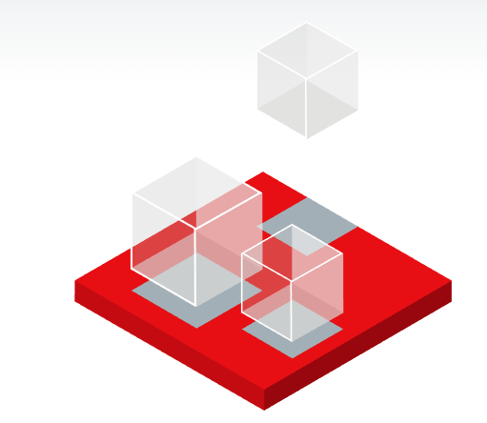


Cloud Native Pipelines

Slide 4
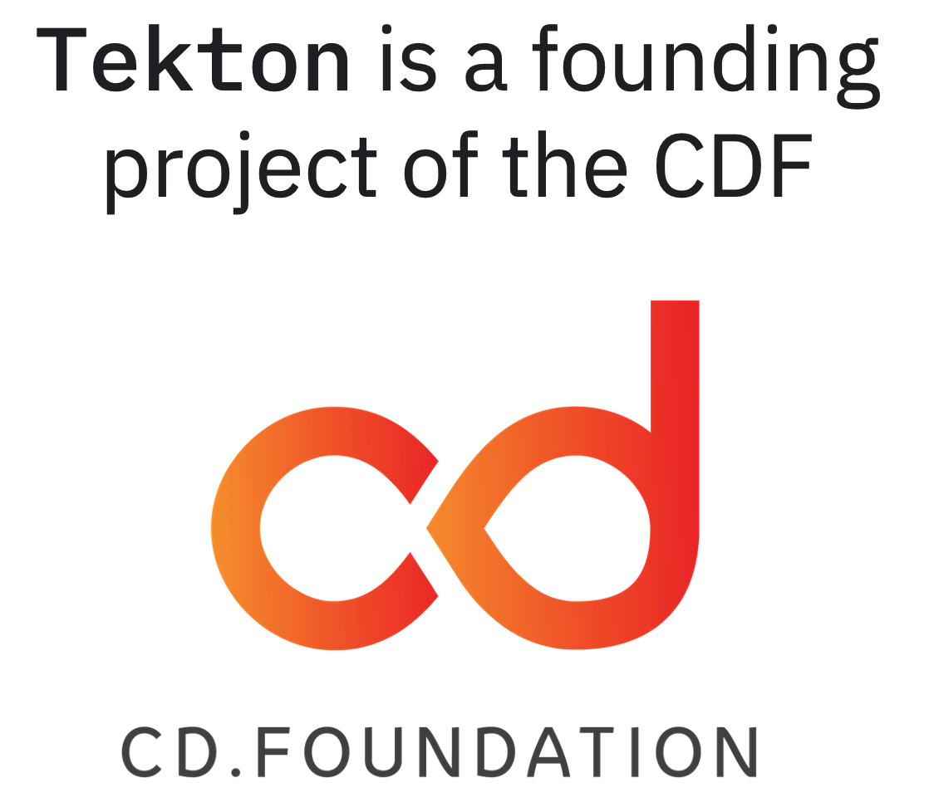
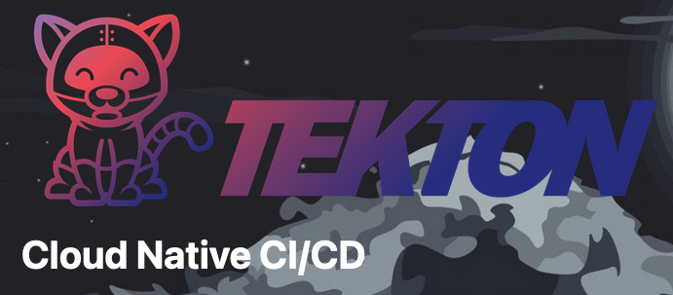
What is Tekton
Kubernetes-native open-source framework for creating continuous integration and delivery (CI/CD) systems
Donated to the CDF
Group effort, with contributors from more than 150 companies!
Notes:
Tekton n’est pas vraiment récent, je pense qu’on peut remonter à aout 2018 où on a vu les permères beta.
Tekton a d’abord été une partie de Knative puis il a été donné au CDF (Cloud Delivery Foundation) en tant que Tekton.
C’est un effort conjoint de 150 companies, including IBM and RedHat, Google, VMWare, Pivotal, CloudBees and more.

Slide 5
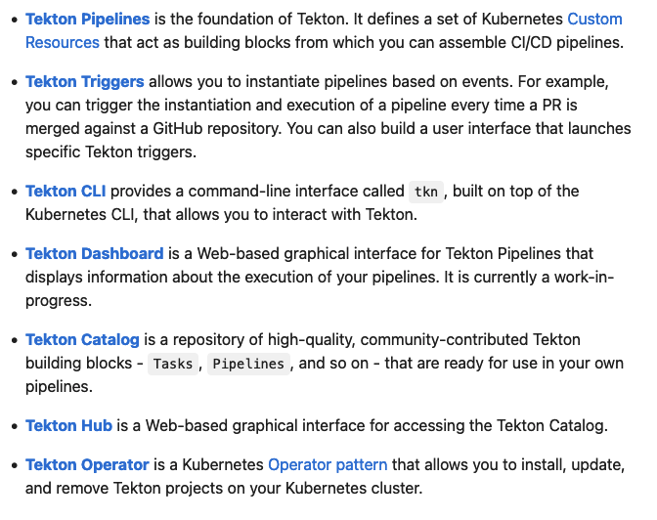
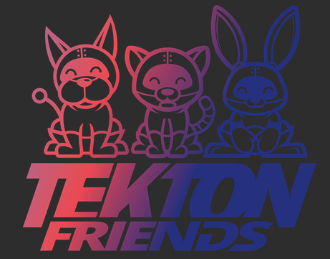
Which Tekton
Notes:
Let’s group the different projects, to help us navigate through them.
The core projects are “Pipeline”, which provides the workflow resources, and “Triggers”, which allows running pipelines in response to events.
Results provides query-able long-term storage for execution history, and chains implements supply chain security for Tekton pipelines.
Catalog provides users with ready to uses Tasks (and Pipelines, coming soon) – to get started quickly composing CI/CD workflows.
Dashboard and CLI are user interfaces, that allow users to browse and manage Tekton resources.
Hub provides an API and UI to search and install resources from a catalog. It’s a similar concept to the Docker and Operator Hubs.
Hub can work with the community-maintained catalog as well as any custom one.
Operator manages the deployment and lifecycle of Tekton projects projects – currently pipeline, triggers and dashboard.
We also have repos for our community resources, infrastructure as code, docs and tekton.dev website.
We run several experimental projects, hosted in the tektoncd/experimental repo.

Slide 6
Why Tekton
Cloud Native
Scalable
Small Footprint
Key tenants:
Reusability
Flexibility
Interoperability
Notes:
Many have asked me "why Tekton", and "shall I use Tekton?" - well, it depends.
Tekton is Cloud Native as its core. It aims to be for pipeline (orchestration) what k8s is for container orchestration.
It also has a very small footprint. Its control plane can scale easily, and it provides scalable and concurrent execution of pipelines.
Its key tenants are reusability, flexibility and interoperability.
In terms of maturity, the Tekton API has been stable for several months now. The latest version is v1beta1 for core projects, and we are working towards a v1 in the beginning of 2022. We introduce changes in the API through feature gates, so new features are considered alpha for some time before they are added to the beta/stable API. We also have a 9 months deprecation policy before we can make a backward incompatible change to the v1beta1 API.
Tekton uses Tekton to create its own CI/CD workflows (which we call “dogfooding”) which means we have a production cluster always running Tekton, updated as soon as new releases are made. Companies like IBM and Puppet offer services based on Tekton. The IBM CD Service runs million of containers per month of customer Tekton pipelines.

Slide 7

Tekton Reusability
Running Workflows:
Task Platform Annotations
Tekton multi-architecture releases
Tekton Windows support (coming soon)
Pipelines:
Catalog Pipelines (small)
Composable Pipelines
Creating Workflows:
Task Catalog & Hub
Task Versioning
Task Best Practices
Design Principle
Notes:
Reusability is one of the key design aspects, and something we always consider when planning new features and reviewing code.
The Tekton community maintains a catalog of Tasks – organization can use that and build their own.
The catalog provides versioning for Tasks and includes a set of best practices that Tasks should follow. There even is a tool called “catlin” to automatically validate some of the rules as part of CI. Tekton Tasks are also available as OCI Bundles in a public container registry. Bundles allow for finer granularity in versioning.
Reusability is so important because for Tekton because it makes it possible to quickly build CD workflows by combining reusable, proven blocks that embody best practices. Reusable tasks mean better scale in authoring: distribute writing and maintaining CD pipelines.
To further foster reusability, the Tekton community is working hard to make sure that Tekton and Tekton tasks may run anywhere.
Tekton itself is built for several architectures, from amd64 to arm, Z and Power. We are also working hard on Windows support, which will soon be available.
Tasks in the catalog are annotated for the platform they can run on.
But what about pipeline? The catalog team is working on enabling support for pipelines in the catalog.
Complex pipelines may be difficult to reuse though. Simple pipeline like clone + build + push are very common though and could be re-used.
One of the areas we are working on to make this possible is pipeline composability.
This is possible today in two different approaches:
An experimental component (pip custom tasks) that allows specifying a pipeline as a task within a pipeline
Connect pipelines through events

Slide 8
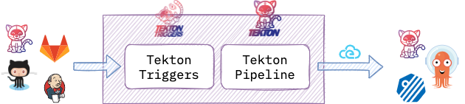
Tekton Flexibility
Jenkins X
Catalog and Workflows
Shipwright
K8s Resource
Custom Task
Jenkins
Java SDK
KubeFlow Pipelines
DSL
Input/Output Events:
CDF Events SIG
Tekton + Jenkins
Tekton + Keptn
Notes:
Tekton is very flexible and non-opinionated, it doesn’t mandate specific CD workflows.
One way to use Tekton is on its own, triggered via webhooks. Another option is to benefits of the re-usability and scalability features of Tekton by running Tekton pipelines through a different system. We’ve just seen that events can be used to compose Tekton pipelines. They can also be used to integrate Tekton with other platforms. Tekton Triggers create Tekton resources in response to events. Tekton Pipeline natively generates CloudEvents for every lifecycle events of its Tasks and Pipelines. CloudEvents are a CNCF projects and spec, to which IBM contributes to.
In this context, a common issue is that different platform may not understand each other events. Solving this is the mission of the Events SIG at the CDF. They specify common semantics for events and thus enable communication between different platforms with no need for point-to-point integrations. The SIG has built a POC demonstrating Tekton working with Jenkins and Keptn.
Events is one of the possible ways to integrate with Tekton with other platforms.
Jenkins X is built on top of Tekton, by creating a catalog of tasks and introducing opinionated workflows.
Shipwright defines a k8s custom resource for container builds. It is used by IBM Code Engine and RedHat OpenShift Pipelines. Shipwright own resource manages Tekton tasks. It can be integrated back into Tekton pipelines through custom tasks.
Jenkins has developed a Tekton client through a Tekton Java SDK.
KubeFlow Pipelines allows compiling data / ml pipelines defined in python into Tekton pipelines – a feature contributed mainly by IBMers.

Slide 9
Tekton Concepts

Slide 10
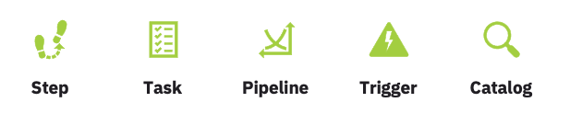

Tekton Buiding Bloks
Notes:
5. composants de base

Slide 11
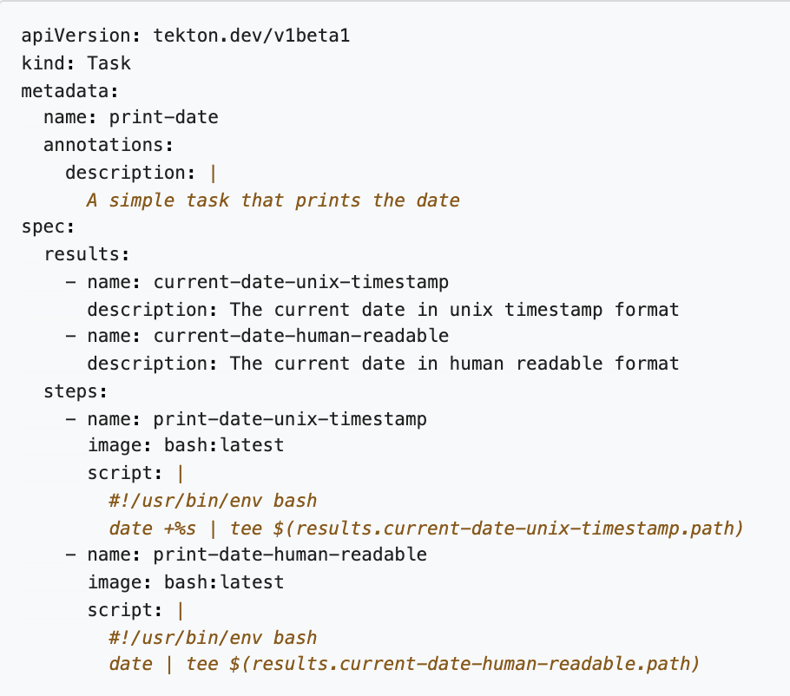
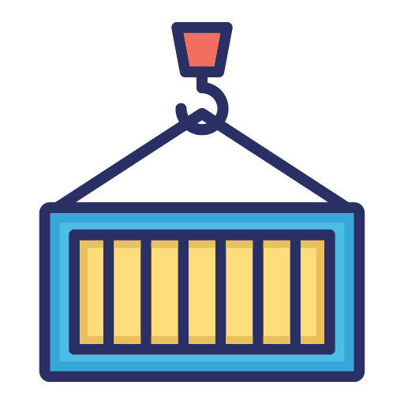
Step
Step
Container
Notes:
The first is a Step which is equivalent to a container image in which it executes a tool on the specified input parameters and produces an output.
Now, we can name the step to signify or identify what the step is doing.
And, specify the container image we want to pull.
Define the environment which is accessible to the container.
The script which is invoked as if it was stored inside the container image.

Slide 12
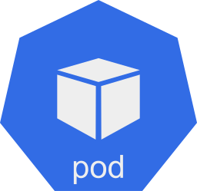
Task
Tekton Internal Workspace
/workspace
sequence of steps
Task
Pod
Notes:
The first is a Step which is equivalent to a container image in which it executes a tool on the specified input parameters and produces an output.
Now, we can name the step to signify or identify what the step is doing.
And, specify the container image we want to pull.
Define the environment which is accessible to the container.
The script which is invoked as if it was stored inside the container image.

Slide 13
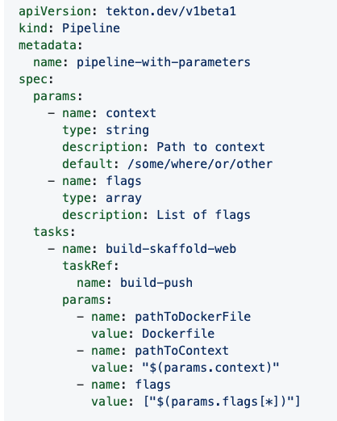
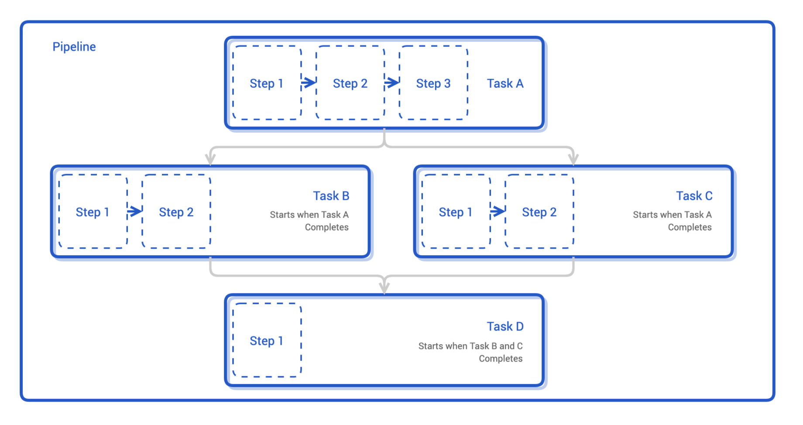
Pipeline
Notes:
The third is a pipeline which is a collection of tasks running a set of pods. A pipeline is a graph which provides the flexibility to organize the workflow based on the requirements. A pipeline combines tasks through parameters, results, and workspace. And also provides a step/task level isolation if needed.
Pipeline is a custom resource of kind Pipeline, and just like Task, we name the pipeline for future reference.
Pipeline specifications include a list of parameters and tasks.
For example, include a git-clone followed by build and in the end deploy the built application.

Slide 14
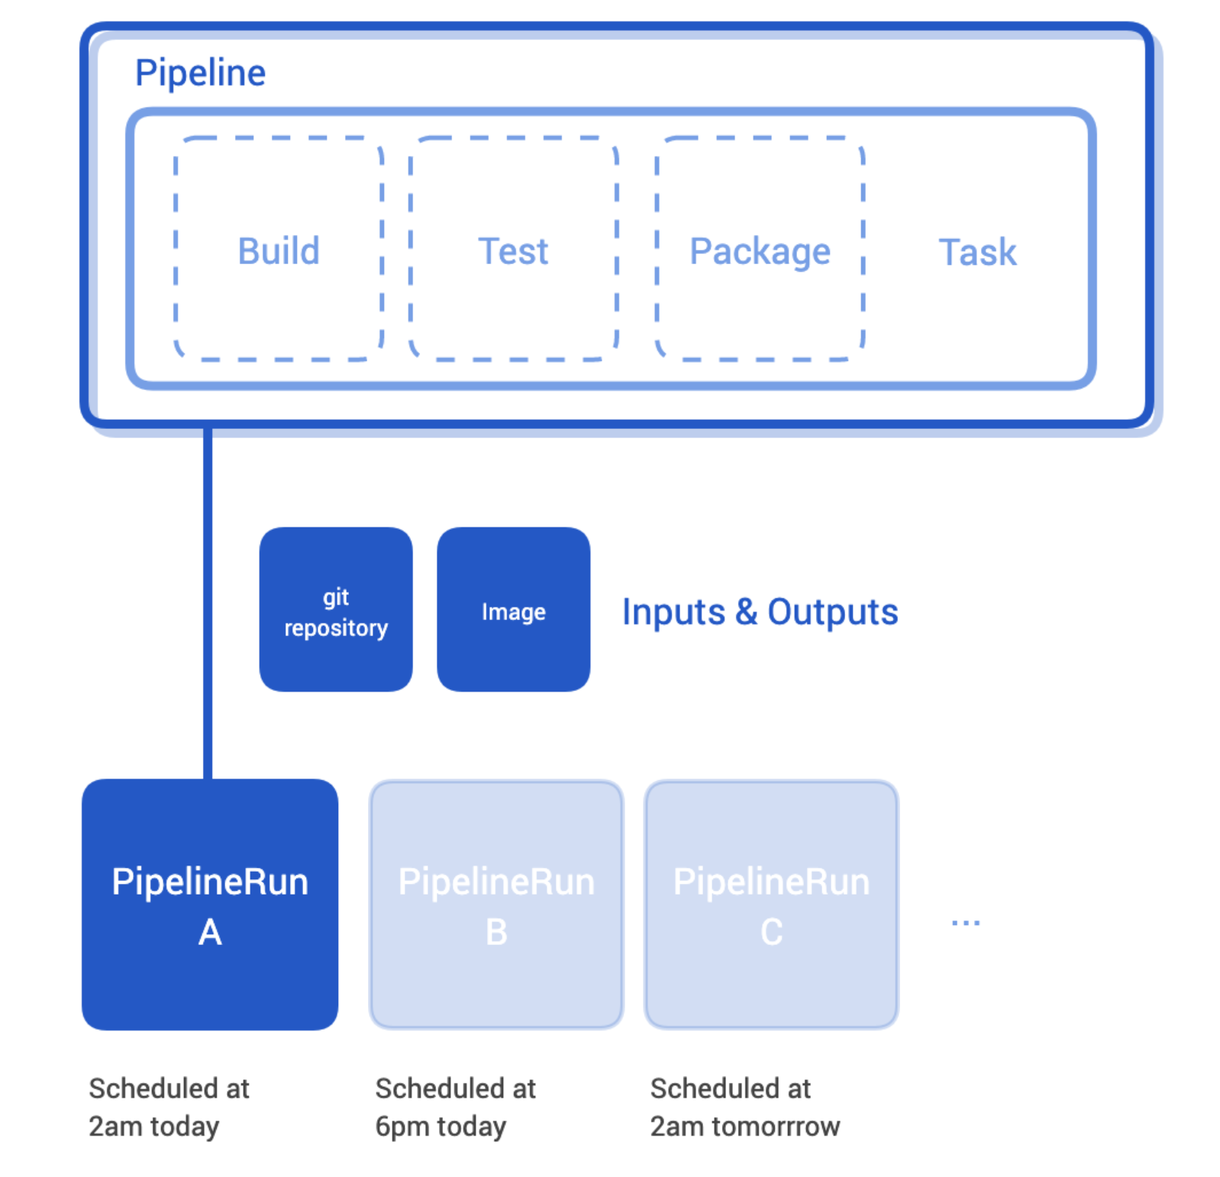
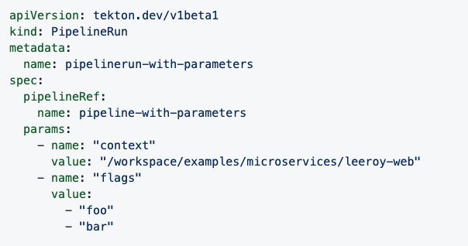
PipelineRun

Slide 15
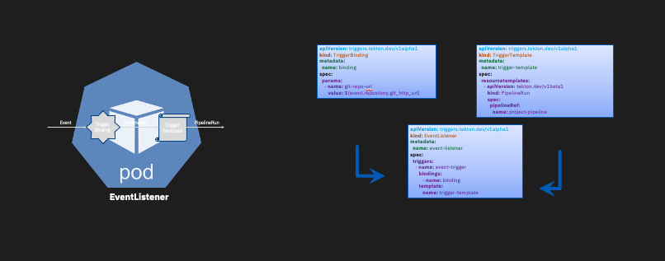
Trigger
Notes:
I can manually run my Tekton Pipeline, but how do I automatically invoke the pipeline, such as when I push a code commit or create a pull request?
For that, we have triggers. The trigger binding extracts the relevant information from the event payload. And, the trigger template provides a blueprint for creating the pipelineRun. Here, the event listener connects the trigger binding to the trigger template.

Slide 16
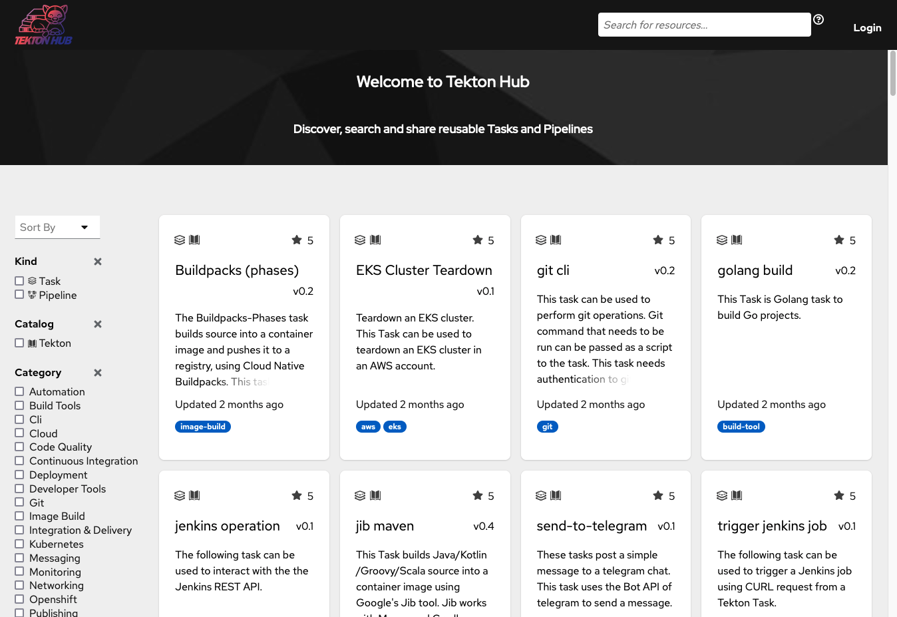
Catalog & Hub
https://hub.tekton.dev

Slide 17
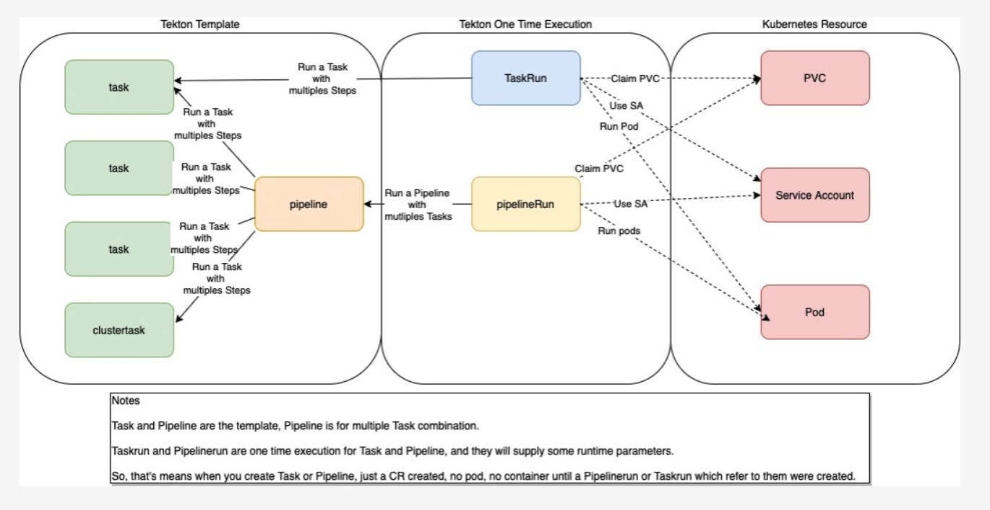
Concepts Summary

Slide 18
Example

Slide 19


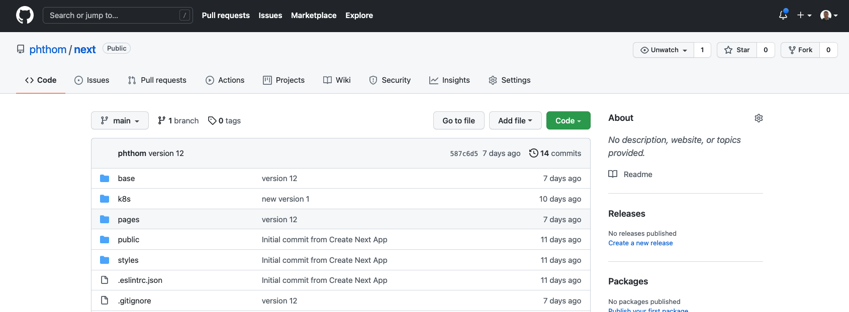
Example

Slide 20

Action Chain
Push
Git Repo
Clone
Run CI tests
Build
Push
Kubernetes
Manifests
Deploy
to Dev
Store
Manifests
Deploy
To Prod
Source
Code
Container
Registry
Manifests
Repo

Slide 21

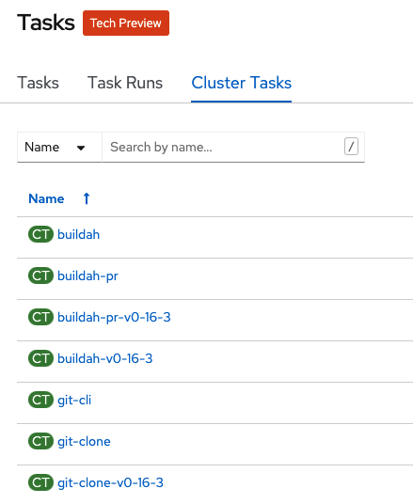
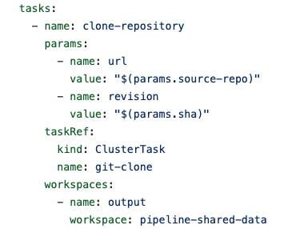
Task#1 Clone
REPO
SSH
Clone
Workspace

Slide 22
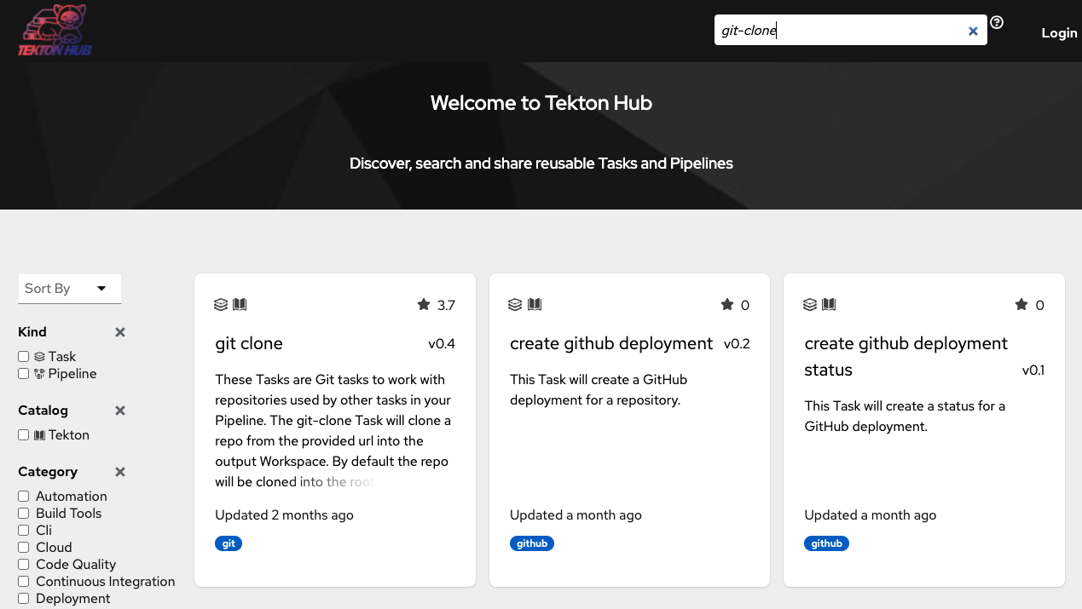
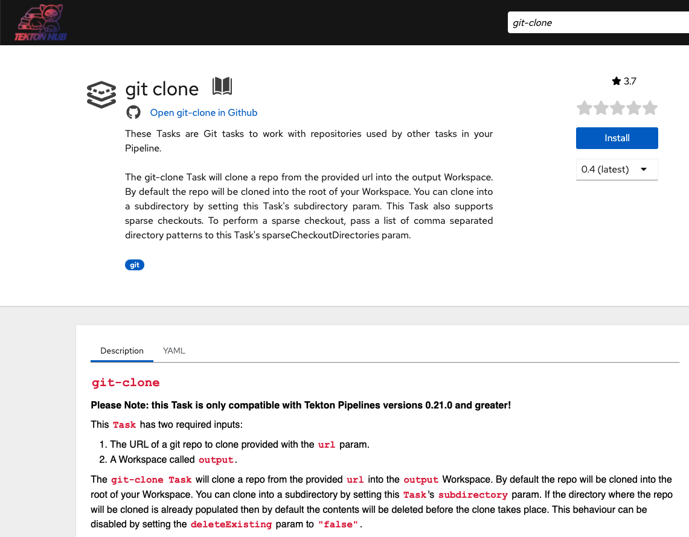
Task Catalog
Notes:
Verification de la compatibilié …

Slide 23
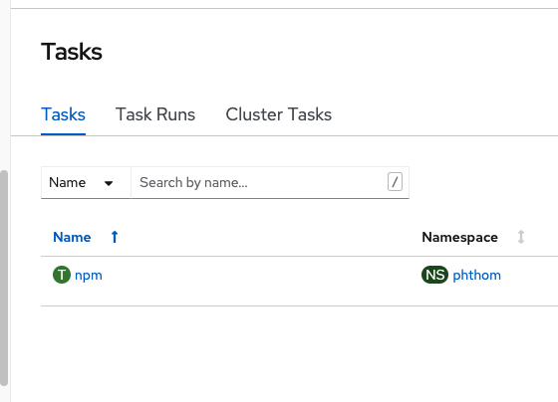
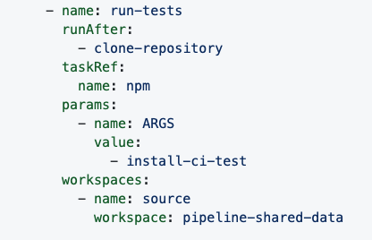
Task#2 CI Tests
RunTests
Workspace

Slide 24
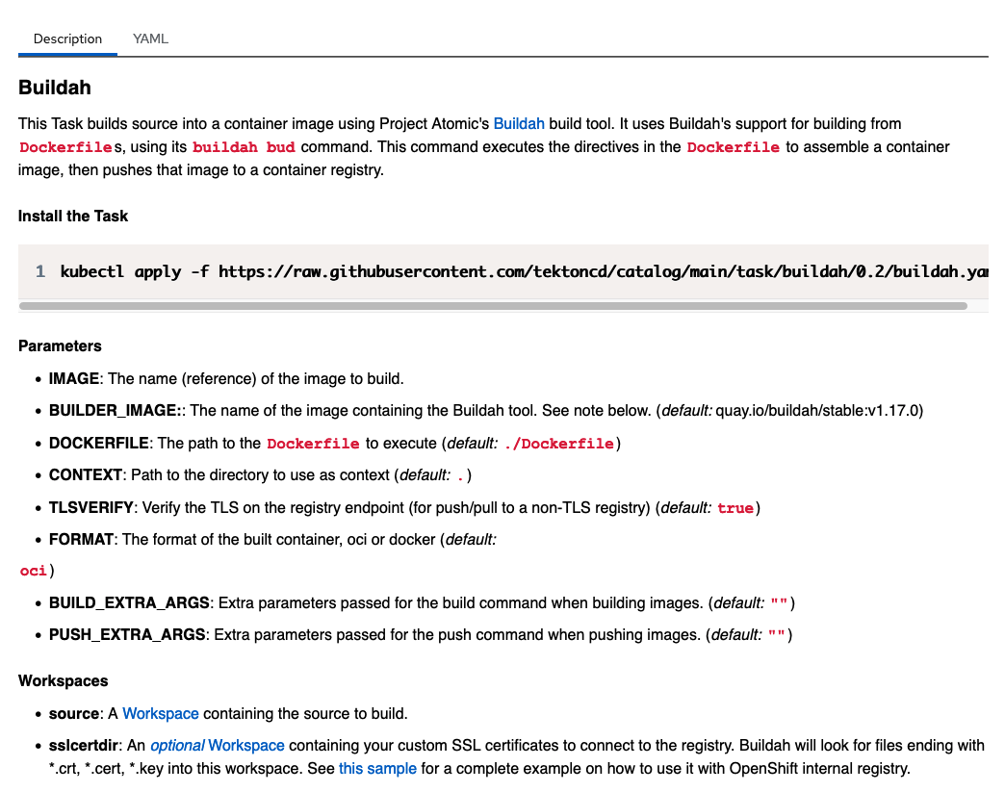
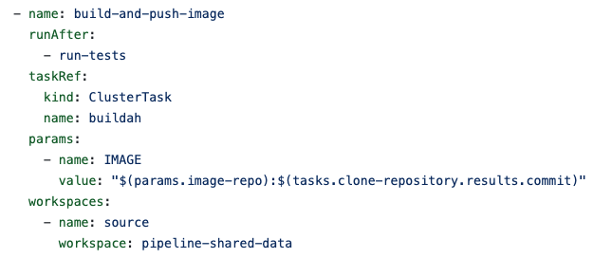
Task#3 Build & Push
Build-Push
Workspace
Buidah has 3 steps

Slide 25
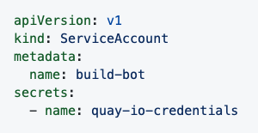
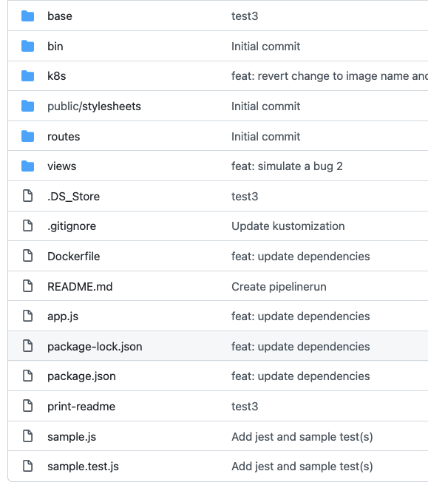
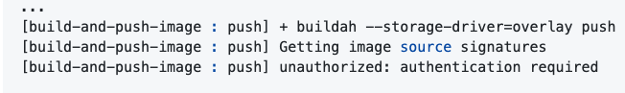
Build & Push
App
Code
Image
Registry
Container
Image
Libs Bins
Config
Push
Buildah
Security access to Registry
(for example quay.io)
./Dockerfile

Slide 26
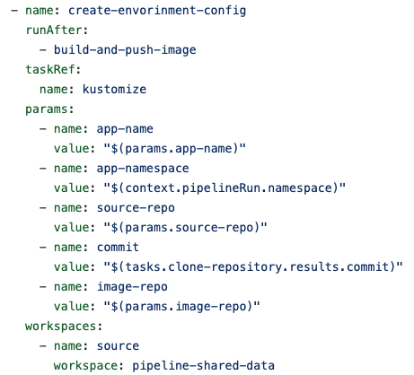
Task#4 Manifests
Project
Namespace
Configmap
Manifests
PV
Secrets
Services
PV Claims
Workspace
Routes
Ingresses
Deployment
Pod

Slide 27
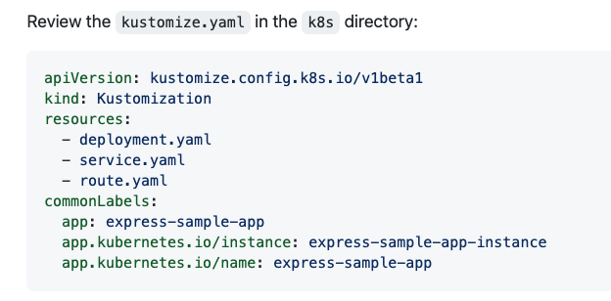
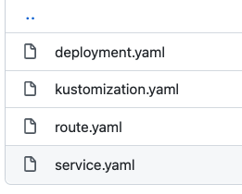
Kustomize
k8s Directory
1 file : manifest.yaml with all resources like sevices, depl, routes, PVC …
https://github.com/phthom/express-sample-app/blob/main/base/kustomize-task.yaml

Slide 28
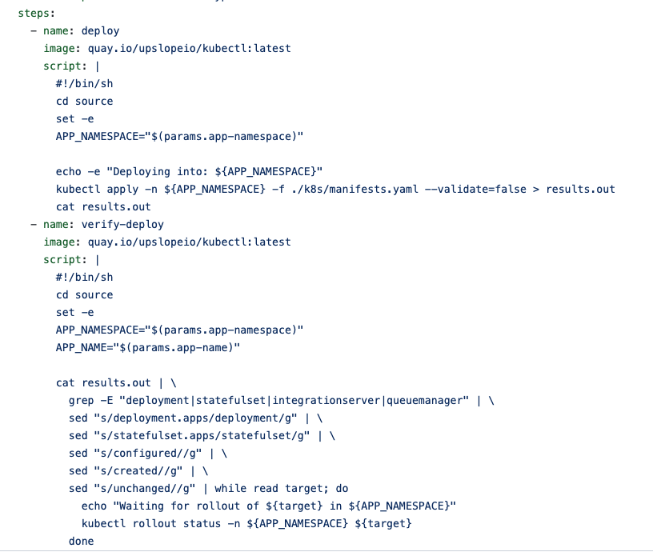
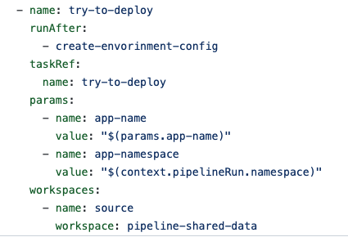
Task#5 Deploy (to Dev)
Deploy
Workspace

Slide 29
PipelineRun
SCM
Clone
RunTests
Build-Push
Manifests
Deploy
Workspace

Slide 30
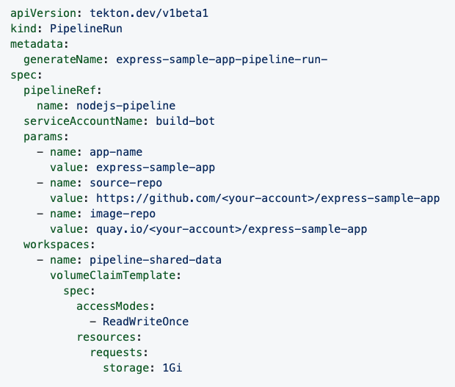
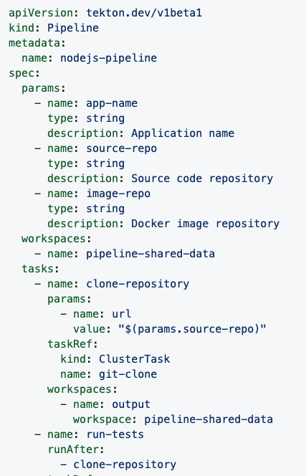
PipelineRun

Slide 31
Triggering
Push
Repo
Security : token
Webhook
Tekton Trigger
To PipelineRun
Clone
RunTests
Build-Push
Manifests
Deploy
Workspace

Slide 32
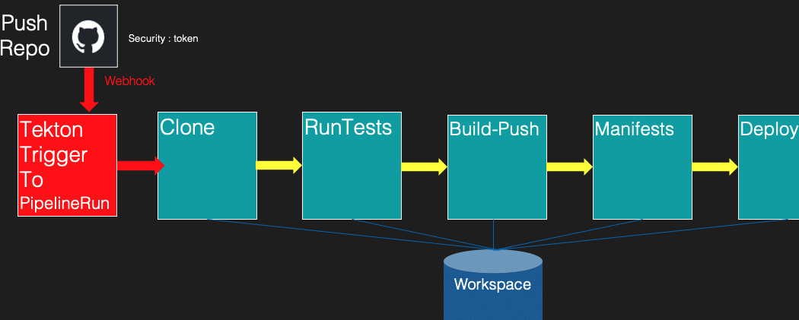
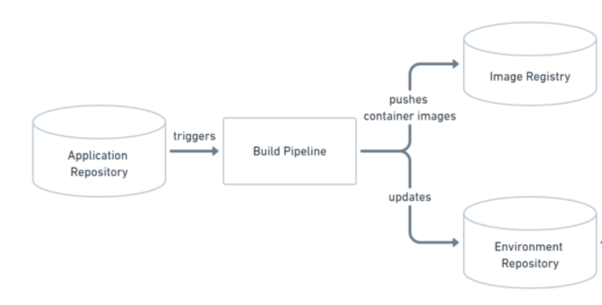
Continous Deployment

Slide 33
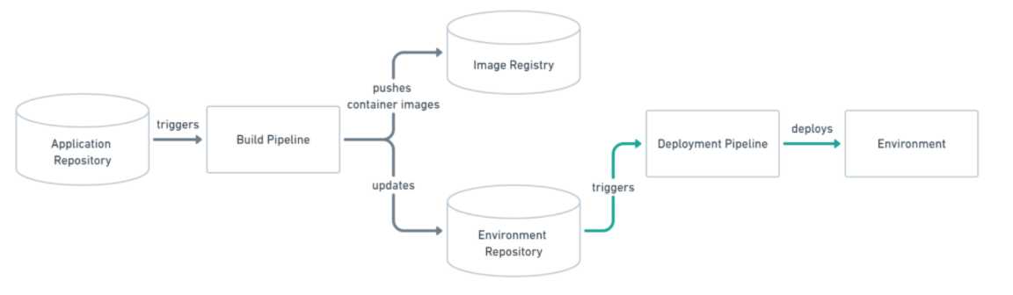
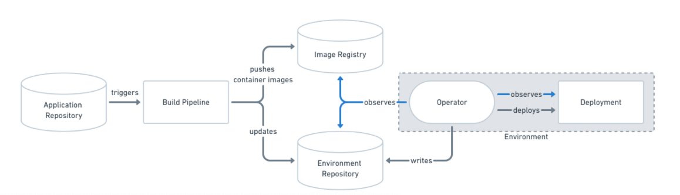
Continous Deployment

Slide 34
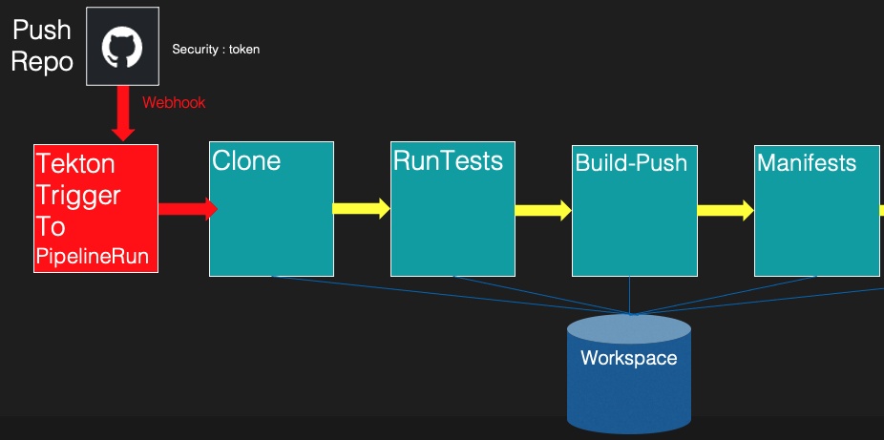
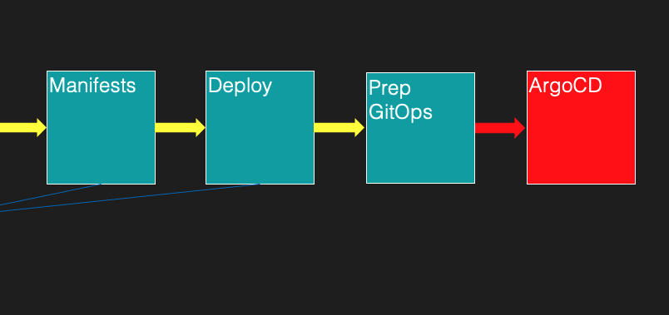
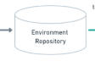
GitOps

Slide 35
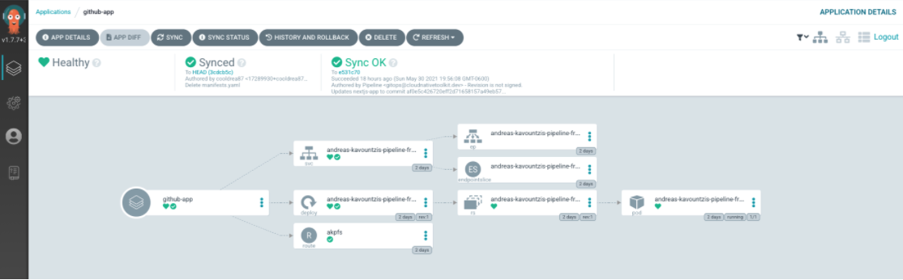
ArgoCD

Slide 36

IBM Offerings
IBM Cloud Continuous Delivery
Enabling development teams to automate the process that moves software through the software development lifecycle
IBM Code Engine
Focus on writing code, not on managing infrastructure
Watson AI Pipelines
Innovating AI lifecycle management with AutoAI
IBM Datastage ETL services
Extract, Transform, and Load
DataStage for IBM Cloud Pak for Data
RedHat OpenShift Pipelines
Cloud-native CI/CD on OpenShift
Notes:
This is the current list of IBM offerings that involved Tekton.
We already talked about IBM CD.
IBM Code Engine is a managed knative that uses Tekton and Shipwright for the source to image service.
Both Watson AI Pipelines and IBM Datastage leverage Kubeflow Pipelines for Tekton.
Finally, RedHat OpenShift Pipelines is a Tekton distribution for OpenShift, integrated with the console for graphical editing of pipelines.
IBM has also an internal offering, part of TaaS (Tool as a Service), that offers a managed Tekton for IBM developers.

Slide 37
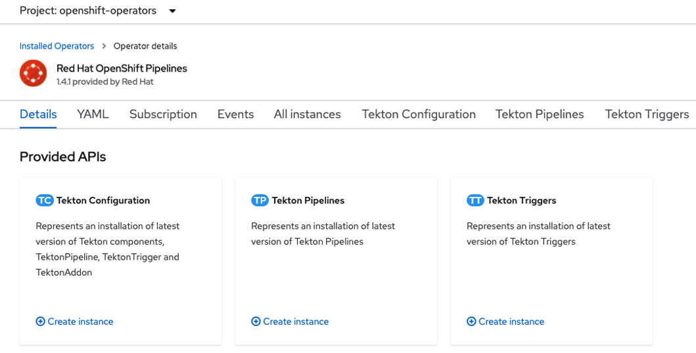
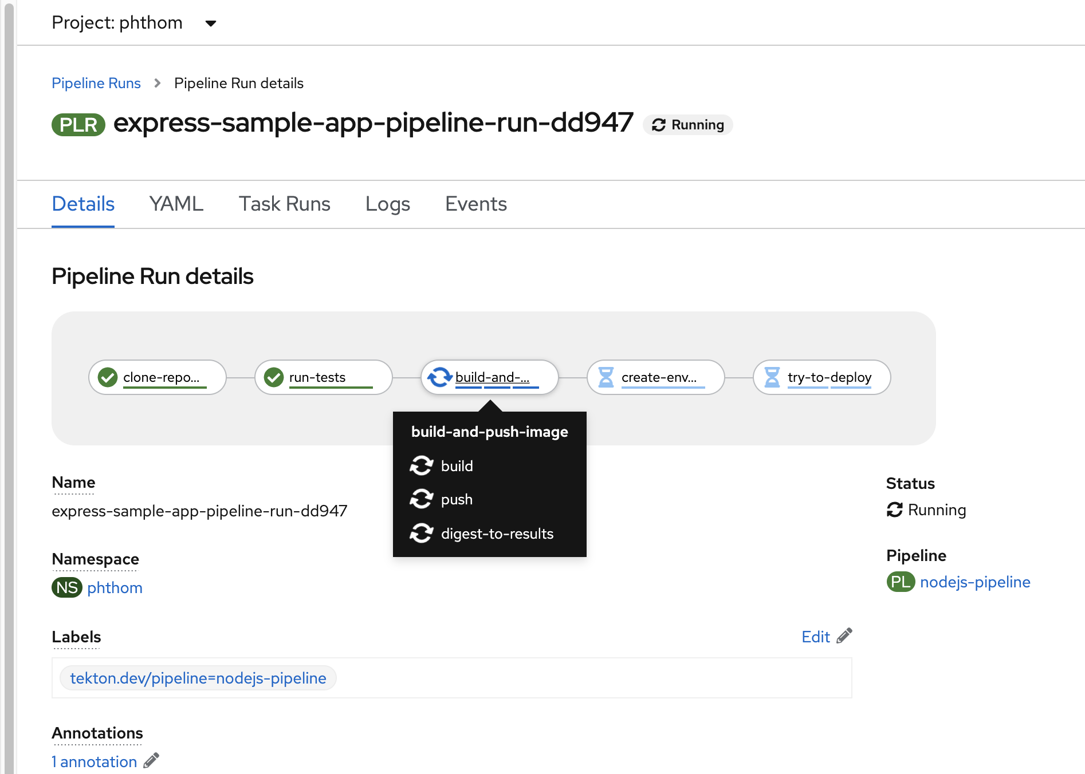
Thanks
Philippe THOMAS
IBM Client Engineering
ph_thomas@fr.ibm.com
www.linkedin.com/in/phthom
https://github.com/phthom

Slide 38
Tekton Reusability
Running Workflows:
Task Platform Annotations
Tekton multi-architecture releases
Tekton Windows support (coming soon)
Pipelines:
Catalog Pipelines (small)
Composable Pipelines
Creating Workflows:
Task Catalog & Hub
Task Versioning
Task Best Practices
Design Principle
Notes:
Reusability is one of the key design aspects, and something we always consider when planning new features and reviewing code.
The Tekton community maintains a catalog of Tasks – organization can use that and build their own.
The catalog provides versioning for Tasks and includes a set of best practices that Tasks should follow. There even is a tool called “catlin” to automatically validate some of the rules as part of CI. Tekton Tasks are also available as OCI Bundles in a public container registry. Bundles allow for finer granularity in versioning.
Reusability is so important because for Tekton because it makes it possible to quickly build CD workflows by combining reusable, proven blocks that embody best practices. Reusable tasks mean better scale in authoring: distribute writing and maintaining CD pipelines.
To further foster reusability, the Tekton community is working hard to make sure that Tekton and Tekton tasks may run anywhere.
Tekton itself is built for several architectures, from amd64 to arm, Z and Power. We are also working hard on Windows support, which will soon be available.
Tasks in the catalog are annotated for the platform they can run on.
But what about pipeline? The catalog team is working on enabling support for pipelines in the catalog.
Complex pipelines may be difficult to reuse though. Simple pipeline like clone + build + push are very common though and could be re-used.
One of the areas we are working on to make this possible is pipeline composability.
This is possible today in two different approaches:
An experimental component (pip custom tasks) that allows specifying a pipeline as a task within a pipeline
Connect pipelines through events

Slide 39
Tekton Flexibility
Jenkins X
Catalog and Workflows
Shipwright
K8s Resource
Custom Task
Jenkins
Java SDK
KubeFlow Pipelines
DSL
Input/Output Events:
CDF Events SIG
Tekton + Jenkins
Tekton + Keptn
Notes:
Tekton is very flexible and non-opinionated, it doesn’t mandate specific CD workflows.
One way to use Tekton is on its own, triggered via webhooks. Another option is to benefits of the re-usability and scalability features of Tekton by running Tekton pipelines through a different system. We’ve just seen that events can be used to compose Tekton pipelines. They can also be used to integrate Tekton with other platforms. Tekton Triggers create Tekton resources in response to events. Tekton Pipeline natively generates CloudEvents for every lifecycle events of its Tasks and Pipelines. CloudEvents are a CNCF projects and spec, to which IBM contributes to.
In this context, a common issue is that different platform may not understand each other events. Solving this is the mission of the Events SIG at the CDF. They specify common semantics for events and thus enable communication between different platforms with no need for point-to-point integrations. The SIG has built a POC demonstrating Tekton working with Jenkins and Keptn.
Events is one of the possible ways to integrate with Tekton with other platforms.
Jenkins X is built on top of Tekton, by creating a catalog of tasks and introducing opinionated workflows.
Shipwright defines a k8s custom resource for container builds. It is used by IBM Code Engine and RedHat OpenShift Pipelines. Shipwright own resource manages Tekton tasks. It can be integrated back into Tekton pipelines through custom tasks.
Jenkins has developed a Tekton client through a Tekton Java SDK.
KubeFlow Pipelines allows compiling data / ml pipelines defined in python into Tekton pipelines – a feature contributed mainly by IBMers.

Slide 40
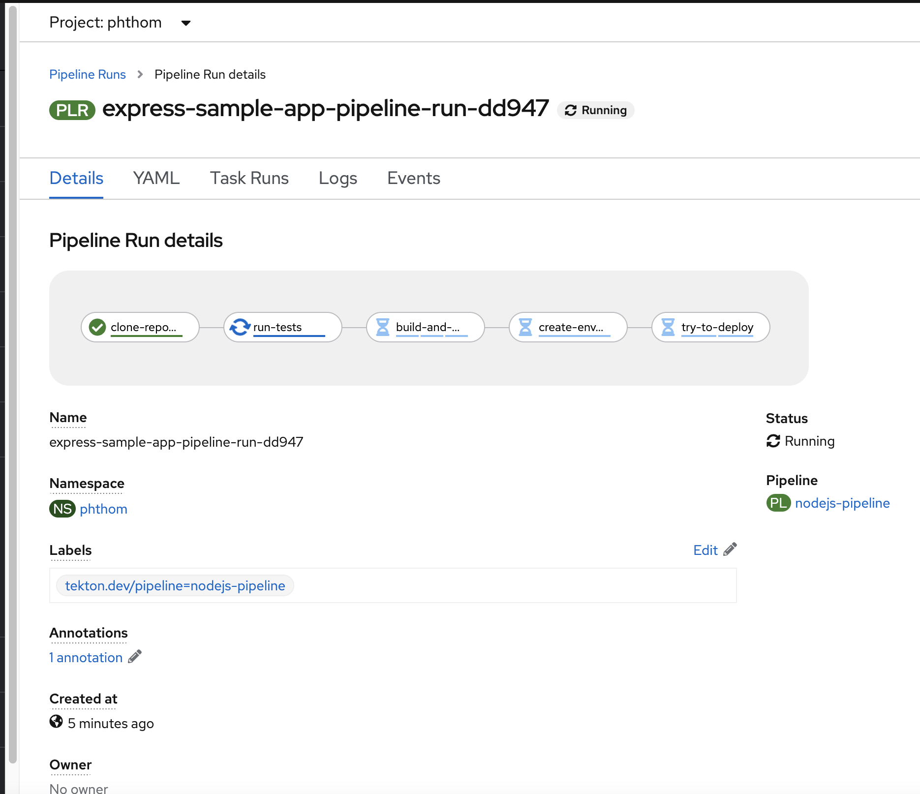

Slide 41
Backup

Slide 42
GitOps
Push
Repo
Security : token
Webhook
Tekton Trigger
To PipelineRun
Clone
RunTests
Build-Push
Manifests
Deploy
Prep
GitOps
ArgoCD
Workspace

Slide 43
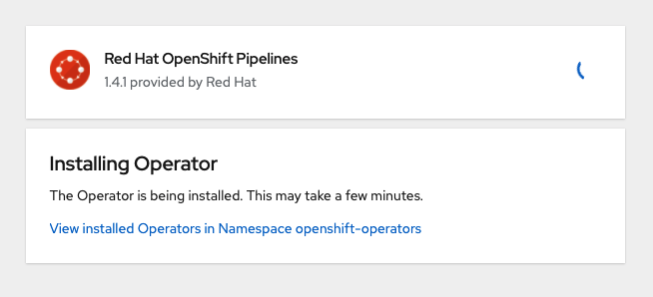

Slide 44
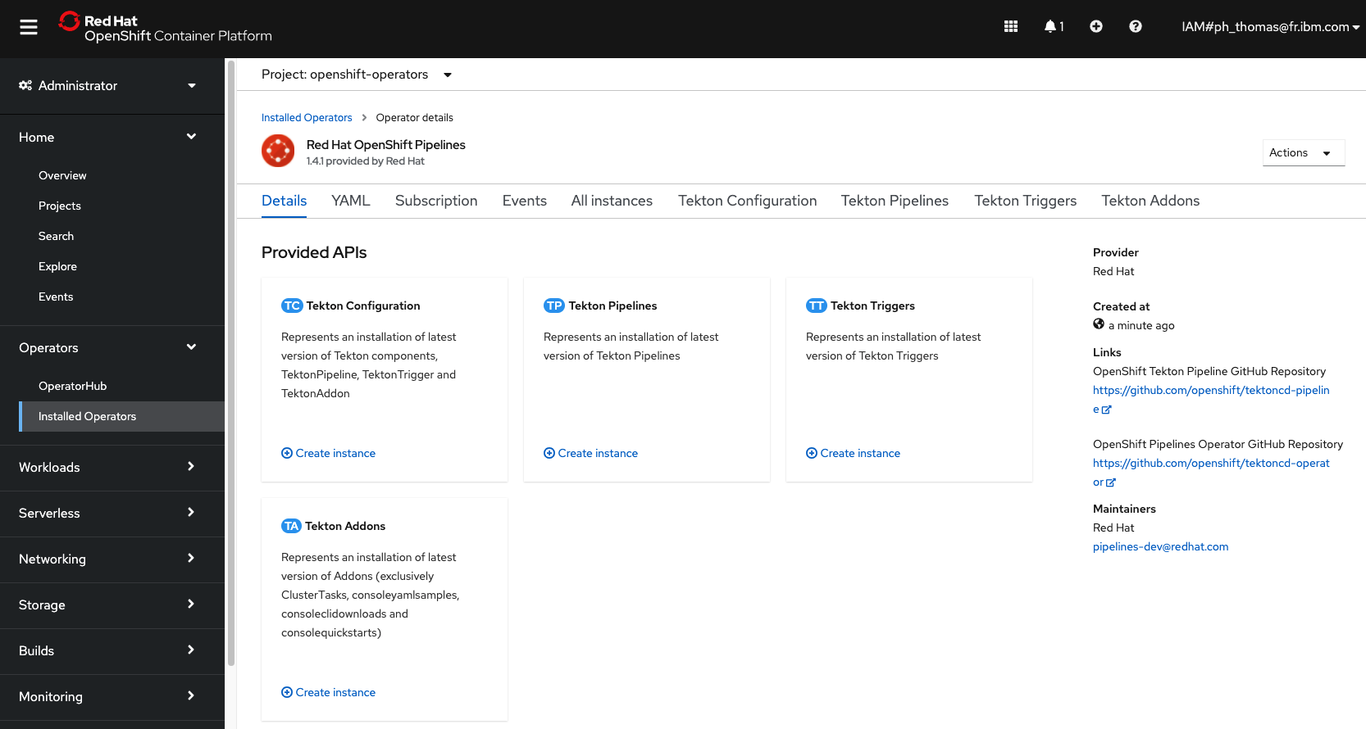

Slide 45
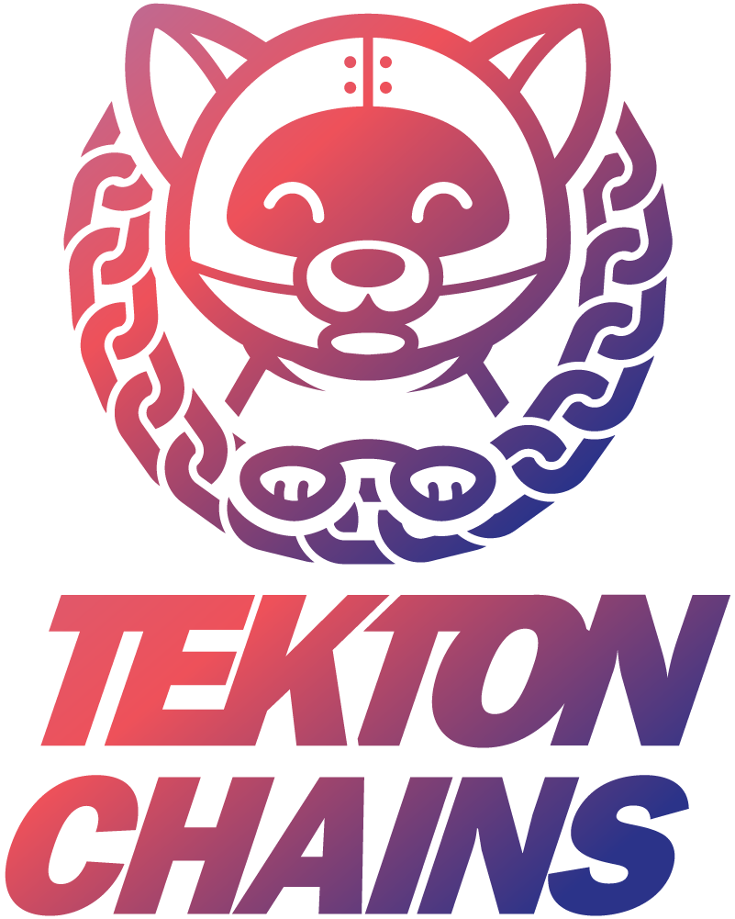
Tekton Security
Hermetic Builds
Signing and Provenance through Tekton Chains
Signed Releases (WIP)
Tekton Vulnerability Management Team
90 days disclosure timeline
Code security audit in progress – issues to be addressed before v1
Notes:
Software supply chain security is a very relevant and actual topic in the CI/CD space.
Tekton is gearing up for it with some new features:
Hermetic Builds allow running a Task disconnected from any external component
Tekton Chains provides signing of container images as well as provenance by integrating with sigstore services.
Tekton is working on its own security! We recently introduced the Tekton VMT that is responsible for evaluating and responding to potential vulnerabilities. Tekton is also working with the CDF to execute a security audit (through an experienced third party) in preparation for the v1 release.

